Slide 1
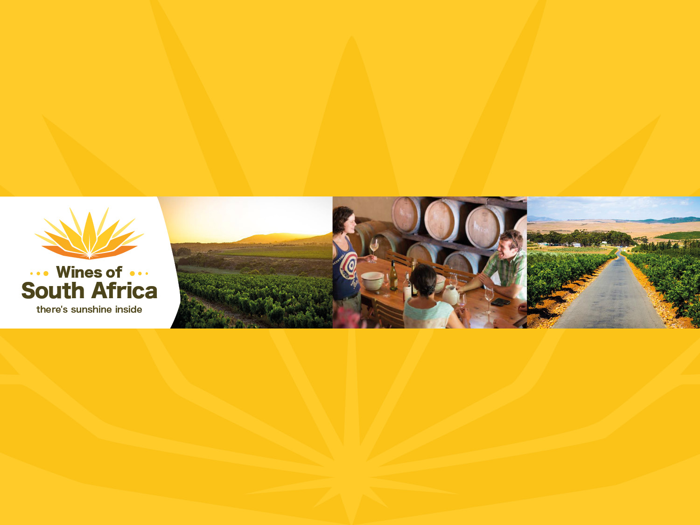
CAPE WINELANDS
BOT RIVER
Notes:
Wines of South Africa

Slide 2

Where is South Africa?

Slide 3

South Africa is the southernmost
country in Africa.

Slide 4

Our winelands are located at the
very tip of South Africa.

Slide 5

PRODUCTION AREAS: Districts of South Africa.

Slide 6

Wards of South Africa.

Slide 7

Cape South Coast
Region: Cape South Coast
District: Walker Bay
Ward: Bot River

Slide 8
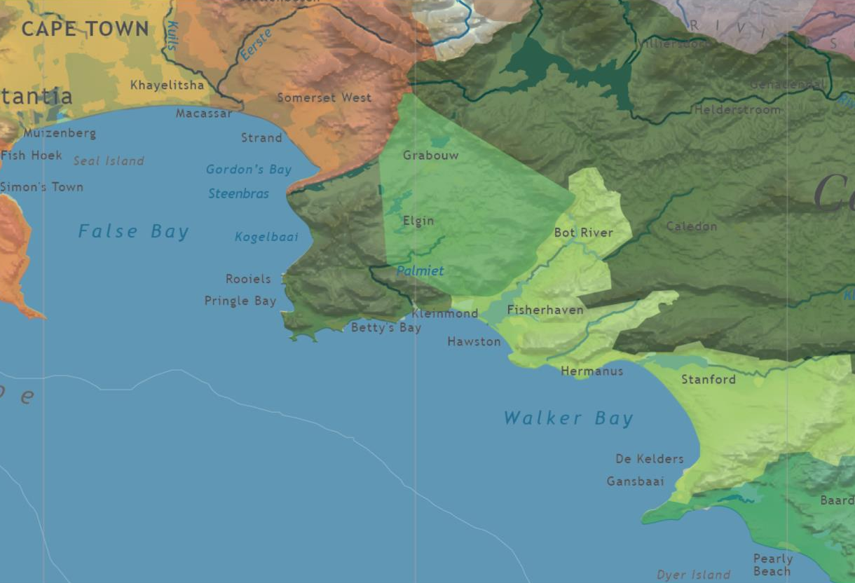

Slide 9
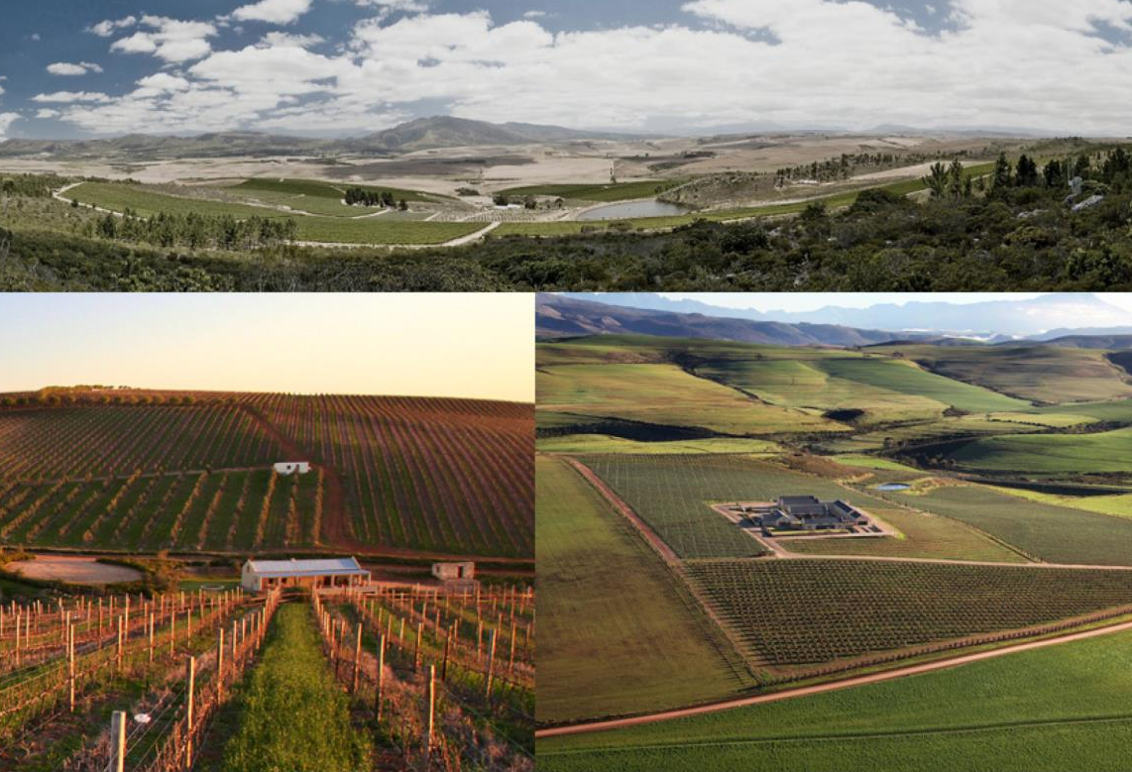
The Bot River Ward, with its vast landscape of rolling wheat lands, vineyards and mountains, is the gateway to Walker Bay.

Slide 10
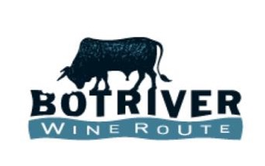
The Bot River, was known by the San people as the 'Gouga’ (meaning 'abundance of fat’). The same word was used for butter, a commodity produced in abundance by the Khoi-San who lived on the banks of the river where pastures were good.

Slide 11
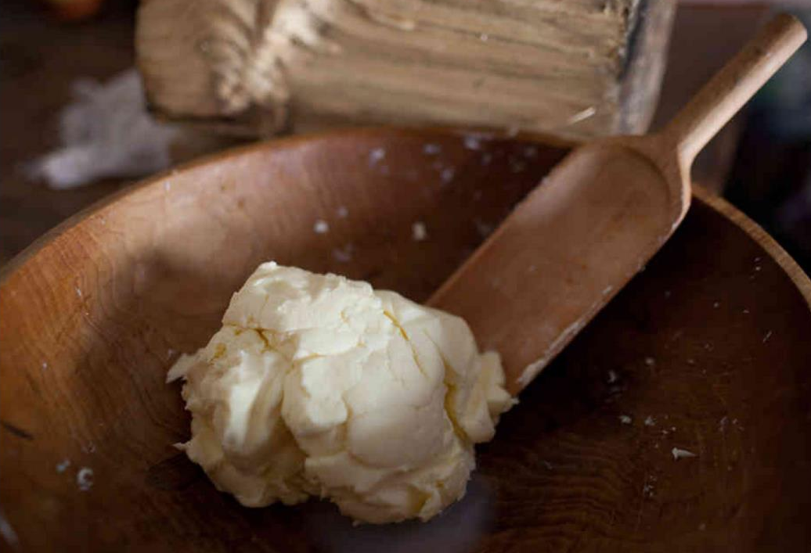
Merchants who travelled from the Cape to trade a variety of wares for full casks of butter named the river Botter (meaning butter) as early as 1672.

Slide 12
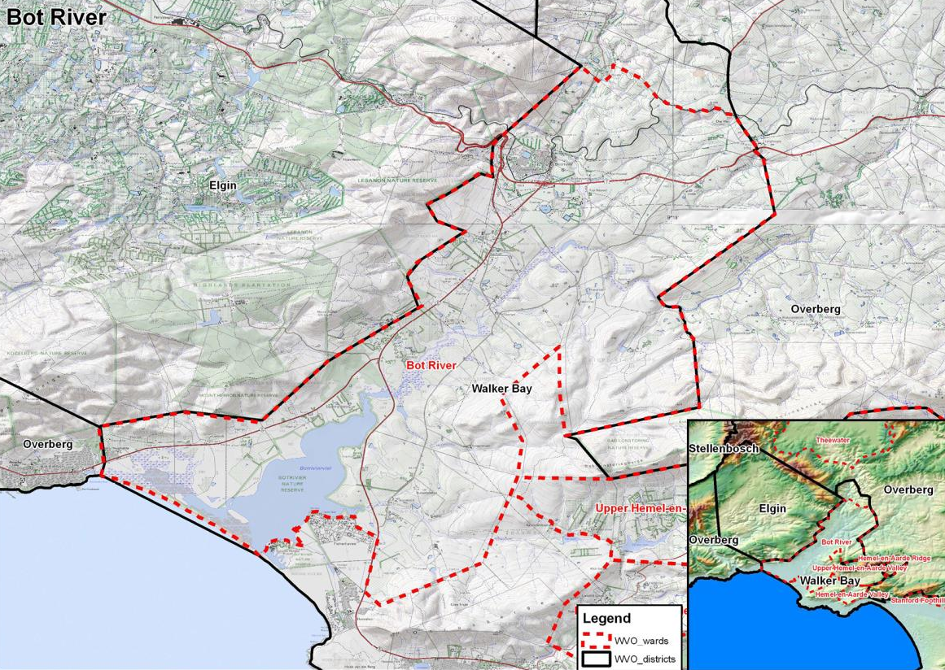
It encompasses the Bot River village and valley.

Slide 13
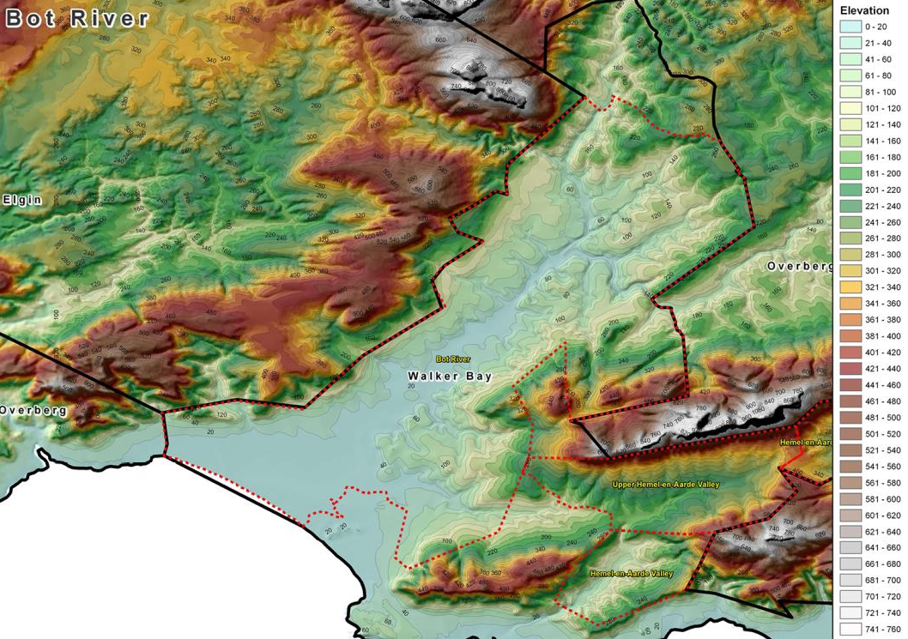
It stretches from the Bot River lagoon up into the foothills of the Groenlandberg and Babylonstoren mountain ranges.

Slide 14
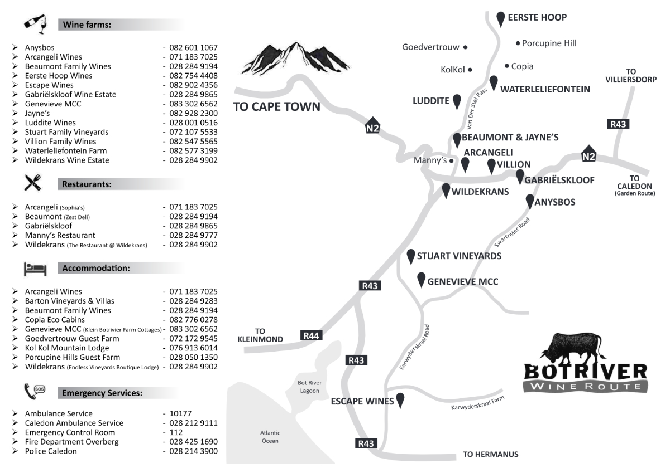
Most of the wineries are centred within a 10 km radius around the village.
.

Slide 15
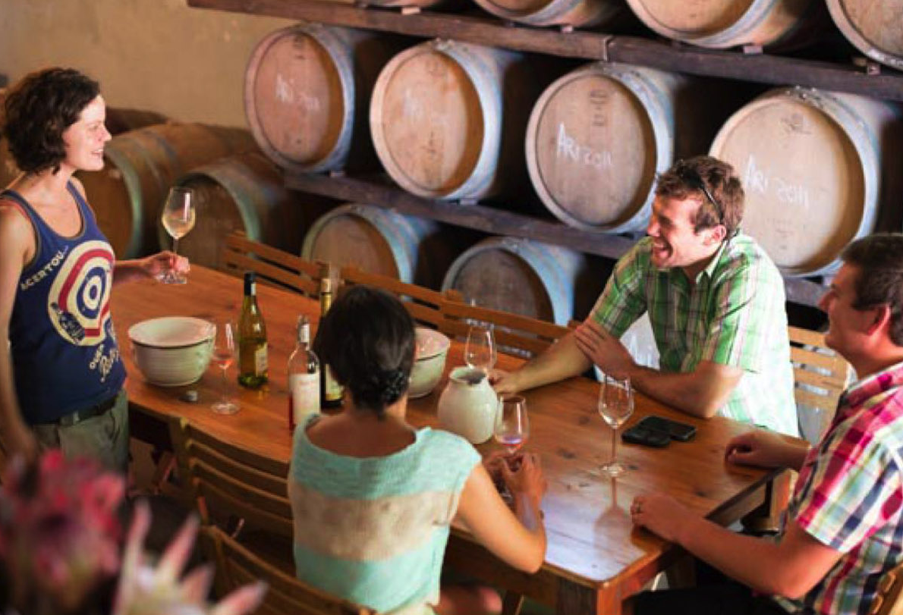
This rustic wine route with its boutique wineries offers
real country hospitality and handcrafted wines.

Slide 16
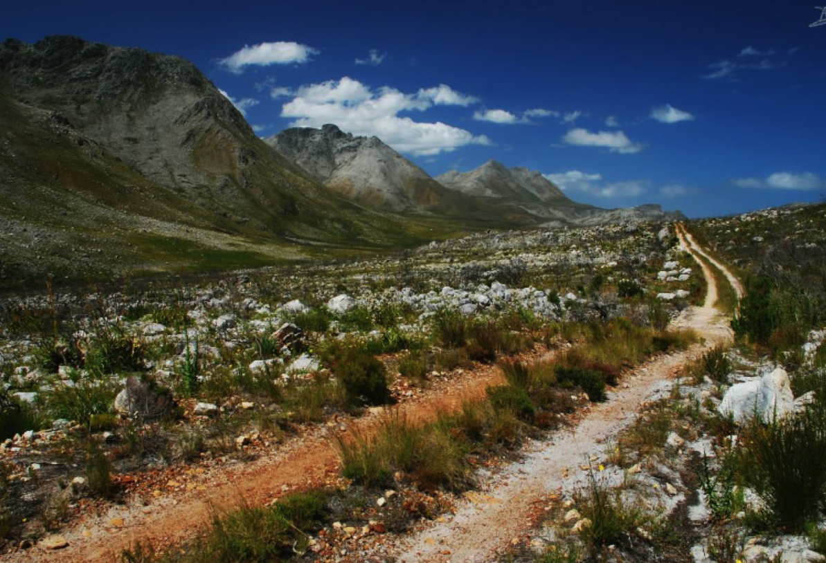
The ward borders the Kogelberg Biosphere. It is part of the Green Mountain Trail, the world’s first biodiversity wine route.

Slide 17
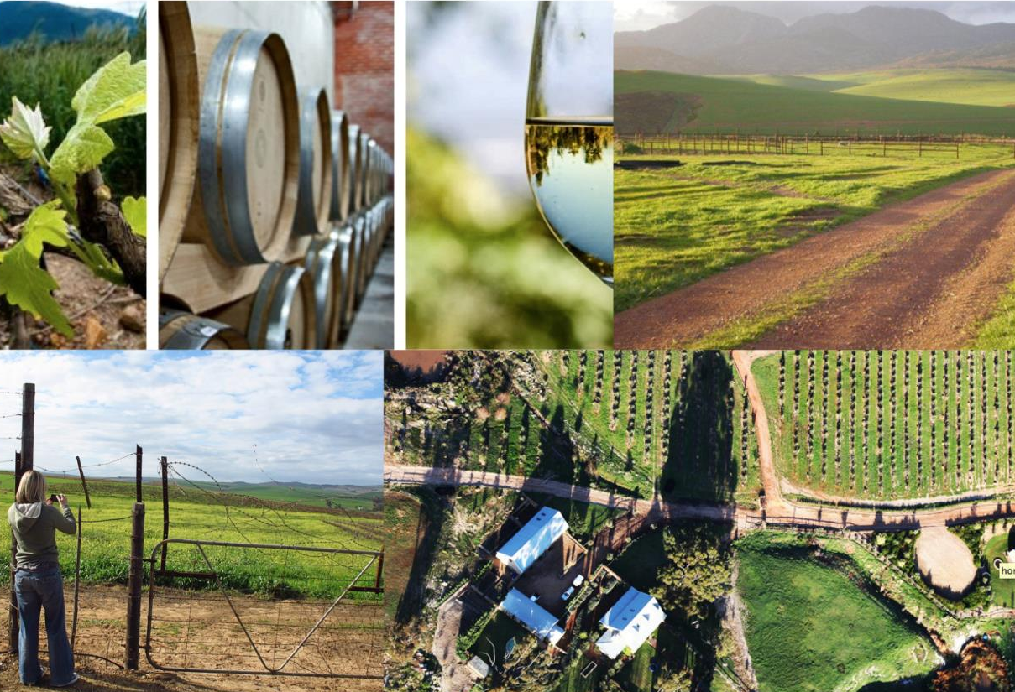
The area is renowned for its cool maritime microclimate, which is influenced by its proximity to the nearby lagoon and Walker Bay. Cooling afternoon winds blow up the valley off the ocean.

Slide 18
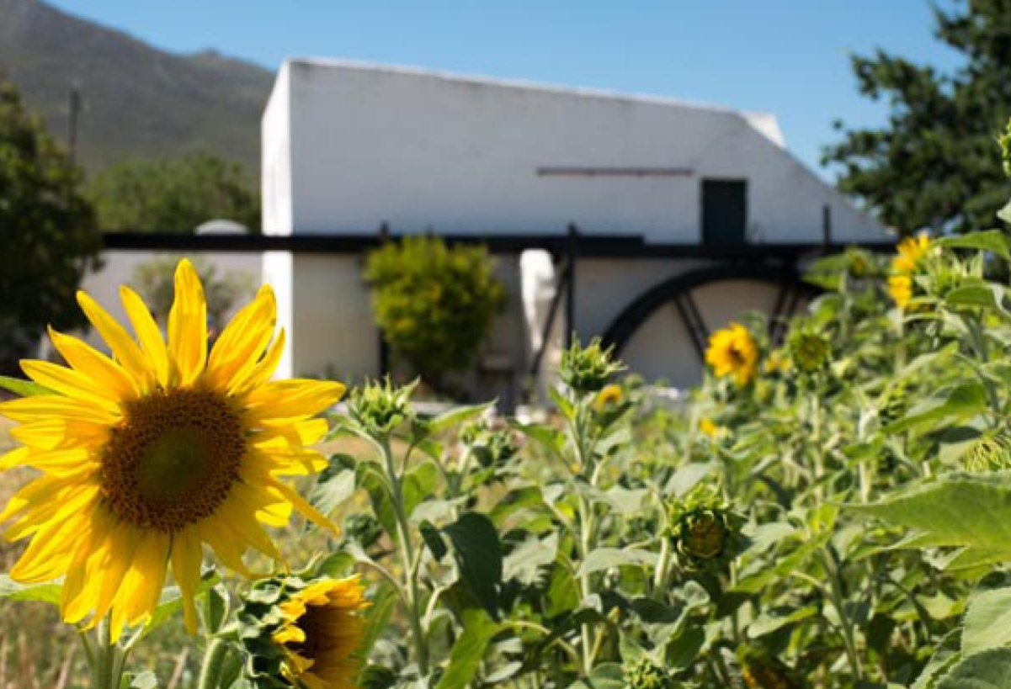
The mean February temperature is 21.2°C and the average annual rainfall is 653 mm (US Climate Grids).

Slide 19
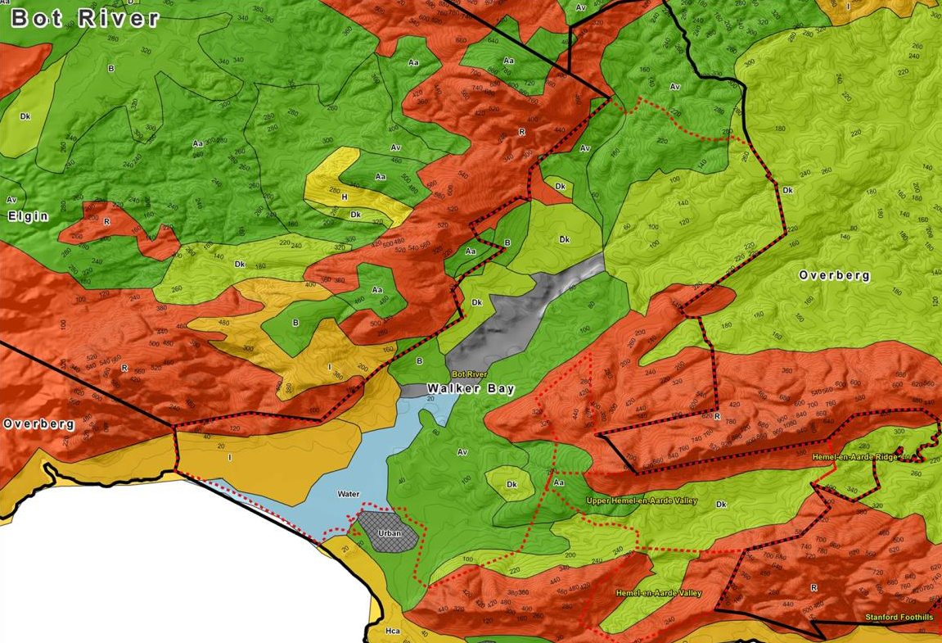
Soils are mainly homogenous Bokkeveld shale (predominantly Glen Rosa and Klapmuts) and Table Mountain sandstone.

Slide 20
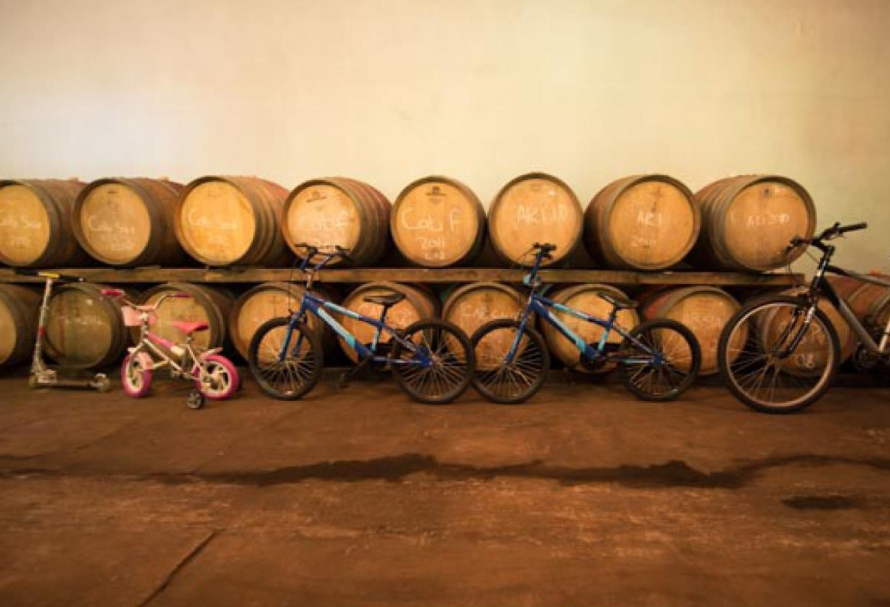
Chenin Blanc, Sauvignon Blanc, Pinotage, Shiraz and other Rhône varieties fare particularly well here.

Slide 21
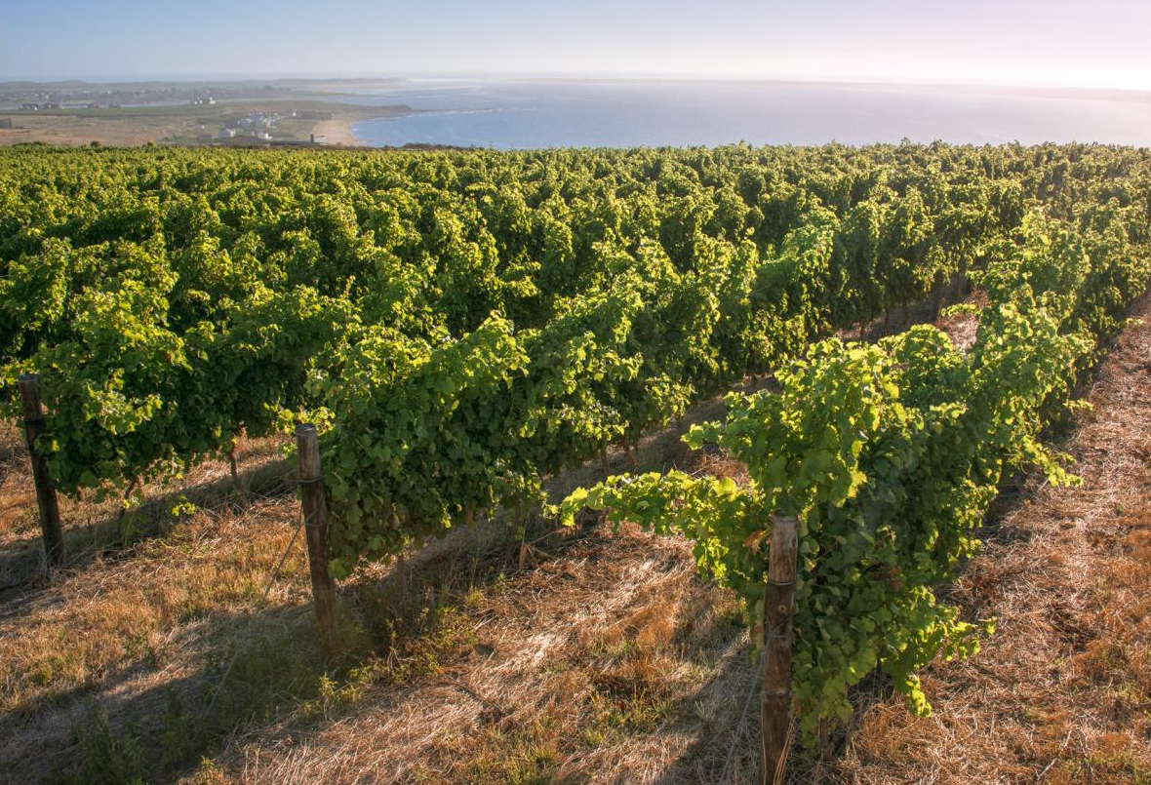
The images used in these presentations have been sourced from various producers, as well as industry and tourism bodies. These presentations are strictly for non-commercial, non-profit, educational purposes only and cannot be reproduced or transmitted in any form or by any means without written permission from Wines of South Africa (WoSA).

Slide 22
The Cape winelands, considered by many to be the most
beautiful in the world, have a network of diverse
and well-run wine routes, affording visitors a varied
and unforgettable experience.
The end
Notes:
The end

